Slide 1
BIOS3010 - Bioinformatics - Spring2020
Introduction to Unix
Anders K. Krabberød
a.k.krabberod@ibv.uio.no

Slide 2
Program for week 19
Introduction to UNIX and Linux
Briefly on the Unix shell, basic commands
Basic Unix exercises
Setting up your computers
Logging on to Saga!
Prepare for what’s to come.

Slide 3
Why learn about UNIX and Linux?
Bioinformatics tools and algorithms are very often developed for UNIX/Linux computers.
Easy to set up pipelines and automate workflows.
Powerful for handling text files and large number of files – very common in modern biology.
Able to work on supercomputers (HPC platforms) e.g. Saga

Slide 4
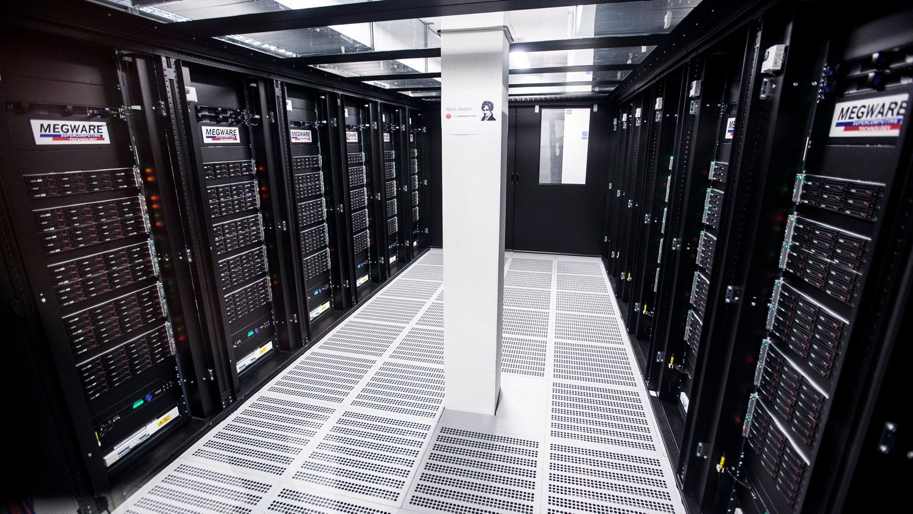
UNIX? Linux? Cpmputer cluster? Saga???

Slide 5
HPC (High Performance Computing) cluster
One of the motivations for learning Linux is that most supercomputers or computing clusters run a version of Linux as the OS.
Most (if not all) of the supercomputer's on the list of the top 500 most powerful computers use Linux.
MareNostrum in Barcelona. 40 000 kg of computers inside an old church. Annual cost in electricty alone is € 1.4m. www.bsc.es

Slide 6
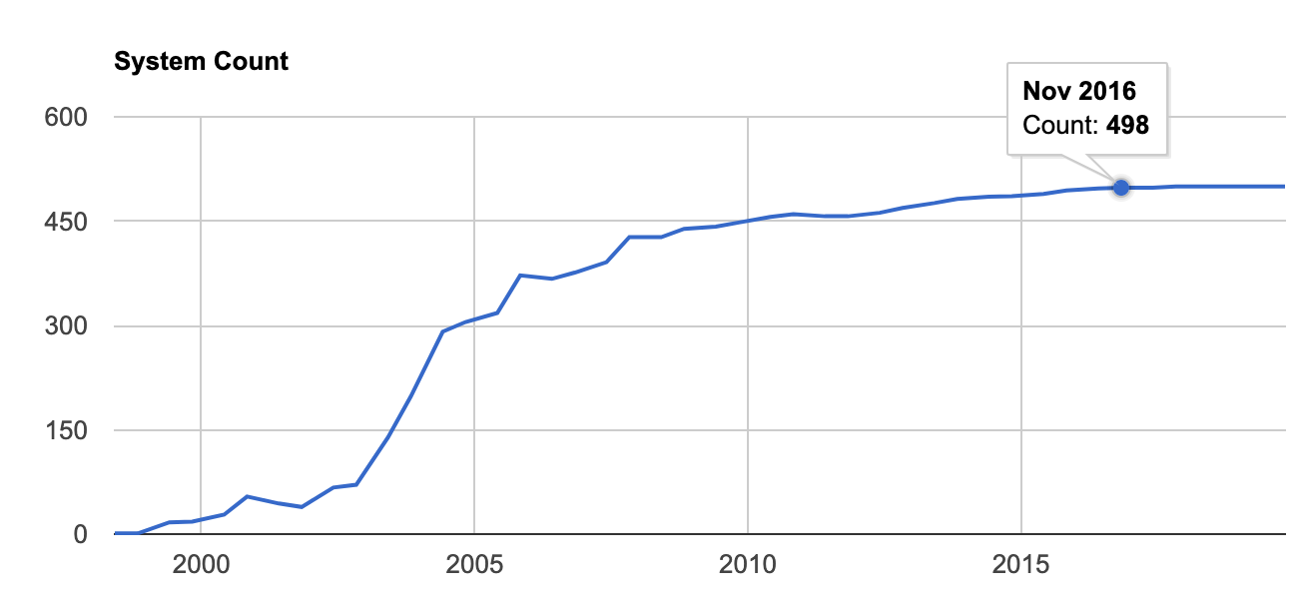
The prevalence of Linux
Linux OS on the top500 supercomputers in the world

Slide 7
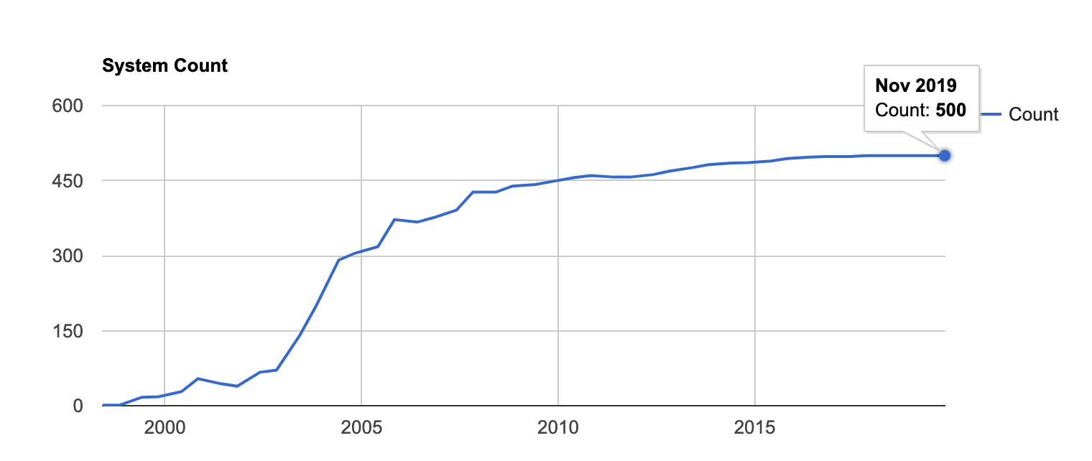
The prevalence of Linux
Linux OS on the top500 supercomputers in the world

Slide 8
HPC (High Performance Computing)
In Norway Sigma2 runs several HPC (High Performance Computing) clusters as well as other e-infrastructure facilities. https://www.sigma2.no/services-overview
Current clusters
Saga
Fram
Vilje
Stallo
Betzy (under construction)

Slide 9
Saga
Details | Saga
System | Hewlett Packard Enterprise - Apollo 2000/6500 Gen10
Number of Cores | 9824
Number of nodes | 244
Number of GPUs | 32
CPU type | Intel Xeon-Gold 6138 2.0 GHz (normal) Intel Xeon-Gold 6130 2.1 GHz (bigmem) Intel Xeon-Gold 6126 2.6 GHz (accel)
GPU type | NVIDIA P100, 16 GiB RAM (accel)
Total max floating point performance, double | 645 Teraflop/s (CPUs) + 150 Teraflop/s (GPUs)
Total memory | 75 TiB
Total NVMe+SSD local disc | 89 TiB + 60 TiB
Total parallel filesystem capacity | 1 PB
We will use Saga for this course
Online as of fall 2019
A computing cluster with 200 standard compute nodes, with 40 cores and 192 GiB memory each,
Total 9824 cores
Access to resources is managed with a queue system: SLURM
OS on Saga Linux

Slide 10
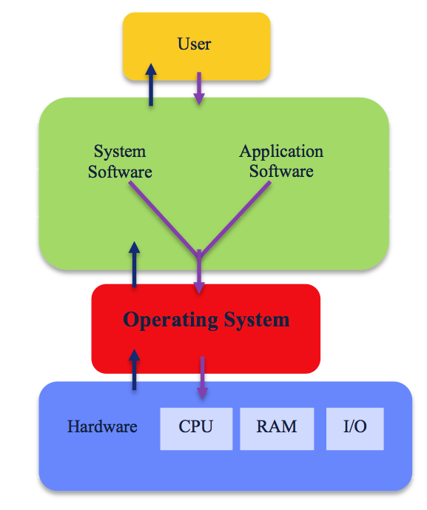
Operating systems (OS)
Software that manages computer hardware
input from keyboard and pointing devices.
output to screen (or file).
keeps track of, reads and writes files.
Provides common services for computer programs

Slide 11
UNIX the mother of (almost) all OS
UNIX was Initially developed in 1969 (Bell Labs / AT&T)
Coded mostly in C (also developed by AT&T)
Multi-tasking (resources are shared)
Multiuser (can handle many users simultaneously)
KenThompson and Dennis Ritchie, two of the UNIX developers

Slide 12
The UNIX philosophy
The success of the UNIX framework is because of the philosophy behind the development
Write programs that do one thing and do it well.
Write programs that will work together.
Write programs to handle text streams, because that is a universal interface.

Slide 13
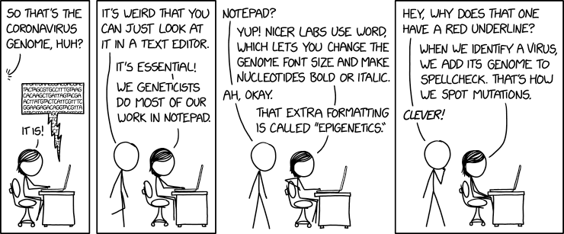
Demystifying files
Many files used in bioinformatics are just text files.
Extension given to the file reflects the format, or how the “internal layout” of that file is.
Often the format is formulated as set of rules that tells the user what the file should contain and how it should be organised
>Seq1
ATGGTATGACCATGT
>Seq2
ATGGTGGCTTGCTG

Slide 14
Demystifying files
Fasta - simplest form
Two lines per sequence
Fastq -
Four lines per s
>Seq1
ATGGTATGACCATGT
>Seq2
ATGGTGGCTTGCTG

Slide 15
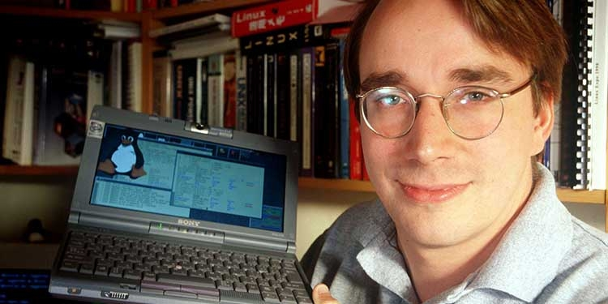

Linux
Development started by Linus Torvalds in 1991
UNIX clone
Free and open Source
Now comes in many variants
Ubuntu
Debian
Centos
++++++
Some variants are portable enough to be installed on a usb pendrive.
Linus Torvalds with the first Linux kernel in 1991

Slide 16
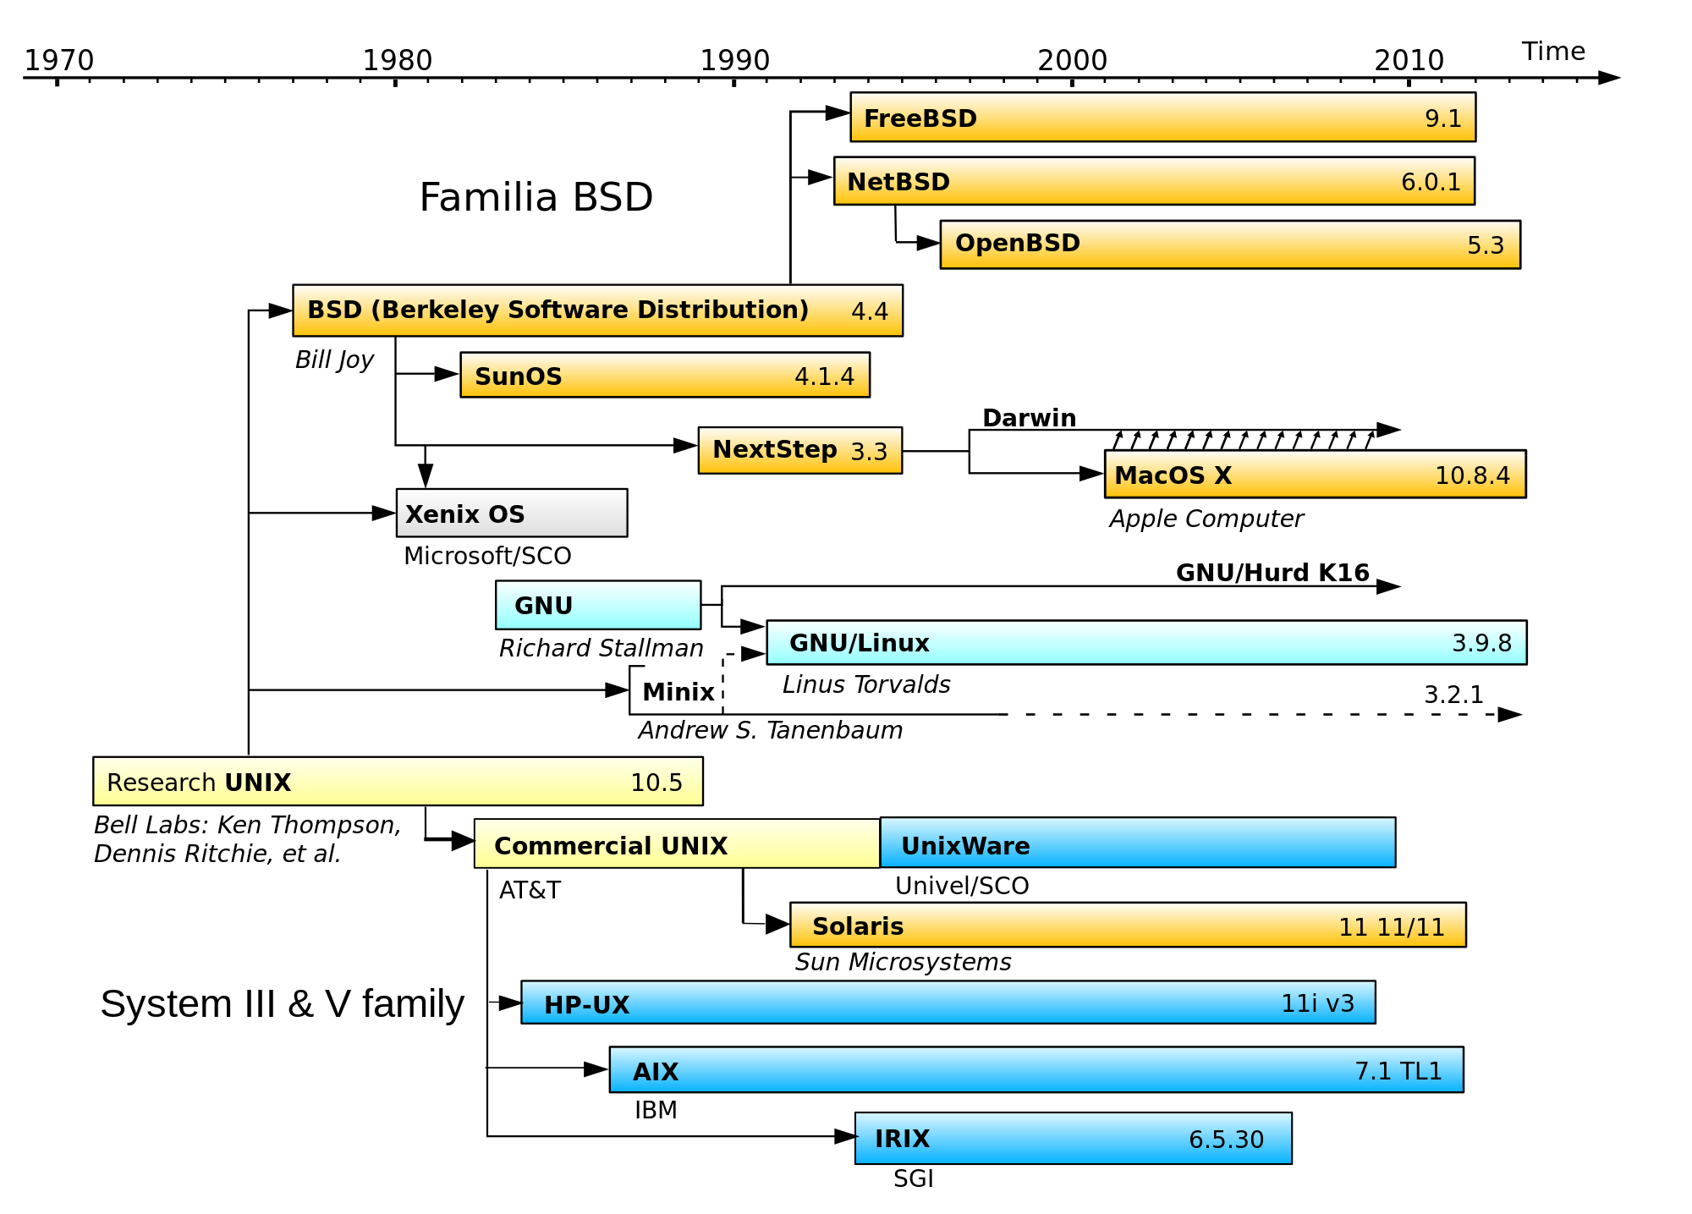
For more about the relation between UNIX and Linux: https://youtu.be/jowCUo_UGts

Slide 17
Advantages with Linux
Stability
Security
Good control of users and processes
Can handle large computing load
Open Source (you can see and modify the code)
Several free options (Ubuntu, CentOS, Debian, etc.)
Large community of developers
Large amount of free software (specially for bioinfo)
Disadvantages
Some hardware may not be supported
Can be less user friendly than other options
(For CLI) It’s not point-and-click

Slide 18
The prevalence of UNIX and Linux
Android phones runs Linux
The MacOS is based on a UNIX clone
The iOS on iPhones is also based un UNIX
The World Wide Web is basically a network of Linux-server
Windows computers do not use UNIX

Slide 19
Poll
What kind of computer do you use?
What kind of OS du you run?
Windows
Mac
Linux?
Have you used Linux before?

Slide 20
Terminology - recap
UNIX is the original OS
Linux is not UNIX, but it is based on the same underlying philosophy (more on this later).
GNU is not UNIX
which incidentally is the intention of the acronym GNU: GNU is a recursive acronym for “GNU's Not Unix
A shell is an access interface for the operating system. It is a program used for controlling and running programs.
Bash is a shell program (others include sh, ash, zsh, ksh…)
A terminal is a program that lets the user interact with the shell. It interprets the keystrokes from the user and passes it on to the shell.
A kernel is the central part of an operating system. It manages the operations of the computer and the hardware, most notably memory and CPU time
POSIX stands for Portable Operating System Interface, and is an attempt by a consortium of vendors to create a single standard version of UNIX

Slide 21
Questions?

Slide 22
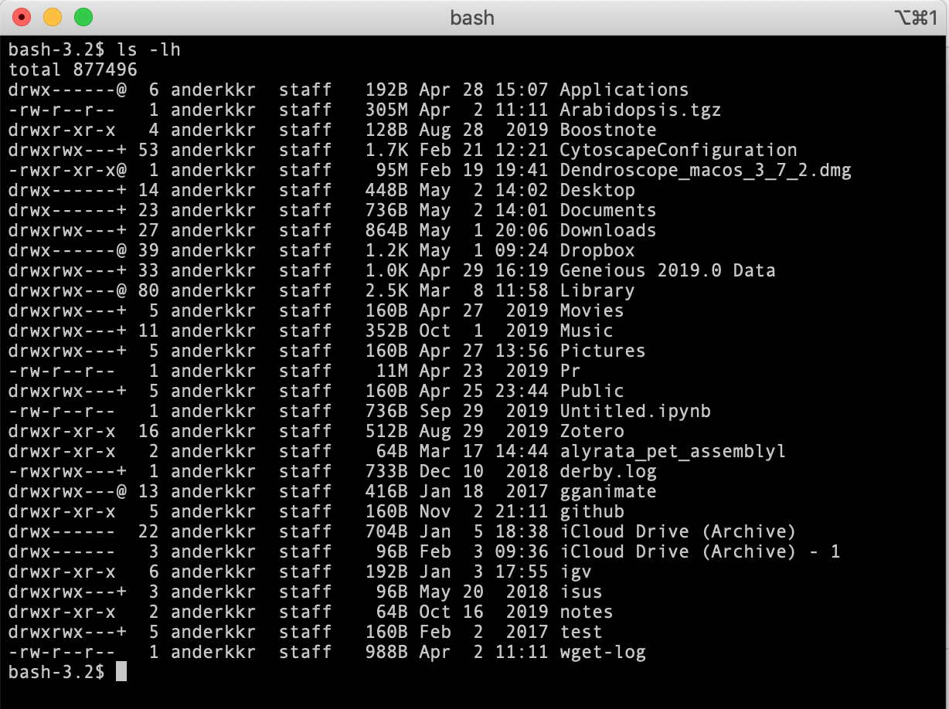
UNIX is text based
You need a way to communicate with the OS
A terminal will interpret your kesytrokes
A shell interprets the commands

Slide 23
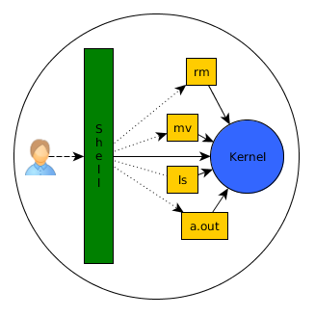
The Shell
The shell is a user interface that provides access to the operating systems services.
It is called a shell because it is the outermost layer around the operating system.
Generally comes in two flavours:
Command-line interface (CLI)
Graphical user interface (GUI)

Slide 24
Command-line interface (CLI) shell
You type in the commands and press enter. The shell figures out how to interpret the commands and which programs to run.
The shell is the user interface for communicating with the computer. There are many different kinds of shells and I won’t go into detail about this. And for most basic use they will do mostly the same. But the most popular Shell is the Bash (Bourne again shell). It is default on most Linux implementations today.

Slide 25
The Shell
The user writes commands on the command line usually in a terminal window
Line-by-line
Step-by-step
Logical work flow
Linux is case-sensitive!

Slide 26
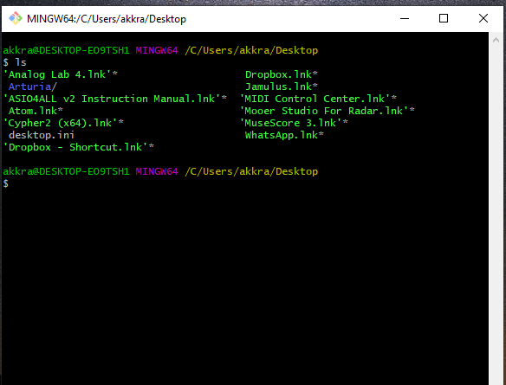
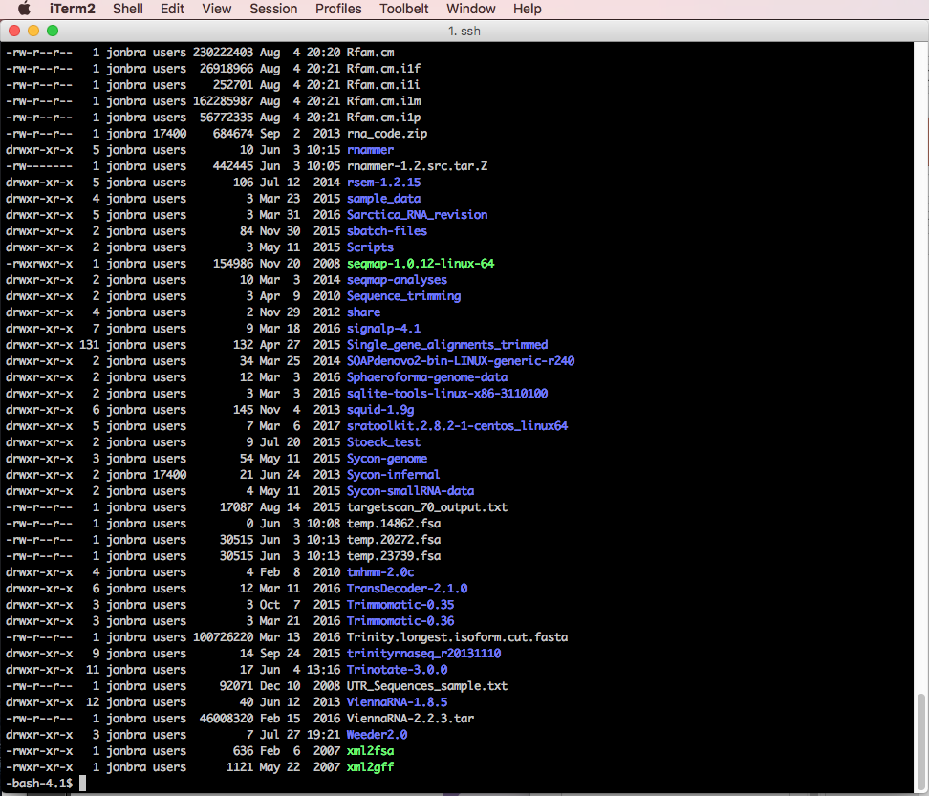
The Shell
We will use the Bash shell (default on most Linux implementations) Bourne-again shell

Slide 27
The Shell
You will need a shell
The shell is a user interface that gives access to an operating system's service
Windows: Gitbash for windows (https://gitforwindows.org/), click download, scroll down and choose the latest 64-bit .exe file. Install then start gitbash from the startmenu.
Other options for shell exists and if you have something you are comfortable with using already installed, that is fine.
Mac and Linux: A shell is already installed (launch Terminal).

Slide 28
If you’ve never used the terminal, you can start with simple commands and a good amount of patience ☺
There’s plenty of resources and documentation online
Goolge is you friend!
A set of instructions and exercises made for the course will help you:
https://github.com/krabberod/bios3010-unix-linux

Slide 29
Poll
Have you used a terminal/shell/command line before?
Do you know how to log on to a server?

Slide 30
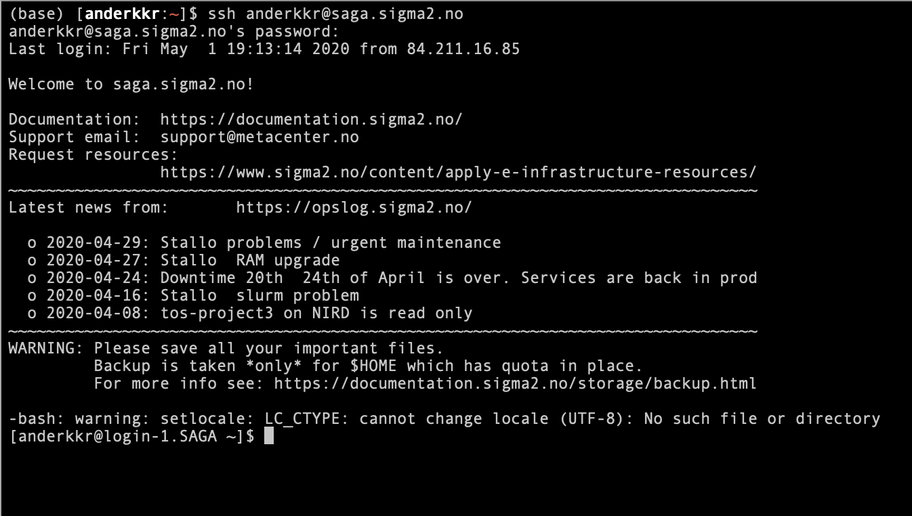
Login into Saga
Open terminal (mac/linux) or start gitbash (windows)
Type ssh <username>@saga.sigma2.no
Type password

Slide 31
Remote login program (ssh)
from man ssh
ssh (SSH client) is a program for logging into a remote machine and for
executing commands on a remote machine. It is intended to provide secure
encrypted communications between two untrusted hosts over an insecure
network. X11 connections, arbitrary TCP ports and UNIX-domain sockets
can also be forwarded over the secure channel.
ssh connects and logs into the specified destination, which may be speci-
fied as either [user@]hostname or a URI of the form
ssh://[user@]hostname[:port].

Slide 32
Coffee break!

Slide 33
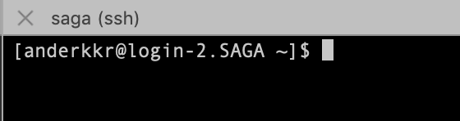
The dollar sign is a prompt, shows that the shell is waiting for input.
The cursor. This is where you write commands

Slide 34
General comments on commands
The commands operates on text. Either files containing text or input from the keyboard (called standard input).
Commands in Linux usually takes the form
command [-options] inputfile
The philosophy of Linux (and UNIX) programs is that they are supposed to be simple and efficient with a standardised way of taking inputs and giving outputs. Because of the standardisation, the output of one command can (often) be used as the input of another command. The advantage of this will be clear later.
The full manual for a command can be accessed with man command

Slide 35
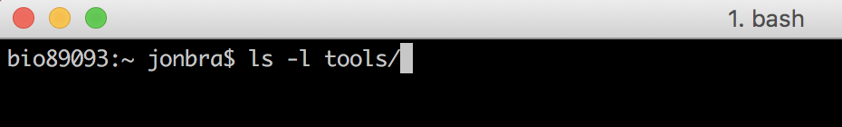
Unix command syntax
command [-option(s)] [argument(s)]
There must be spaces between commands, options and arguments
command
option
argument

Slide 36
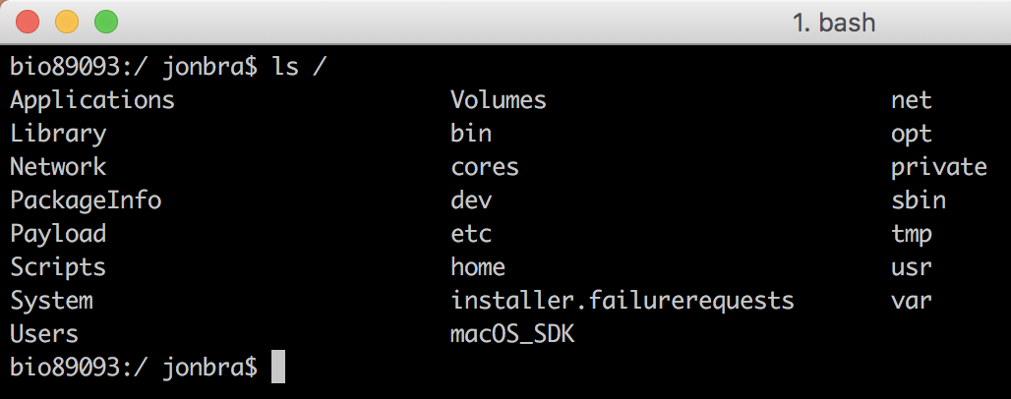
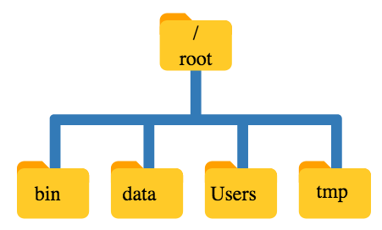
File structure
Unix has a hierarchical file system.
At the top is the root directory that holds everything else. We refer to it using a slash character / on its own
Inside that directory are several other directories:
bin (which is where some built-in programs are stored),
data (for miscellaneous data files),
Users (where users’ personal directories are located),
/(root)
bin
data
Users
tmp

Slide 37
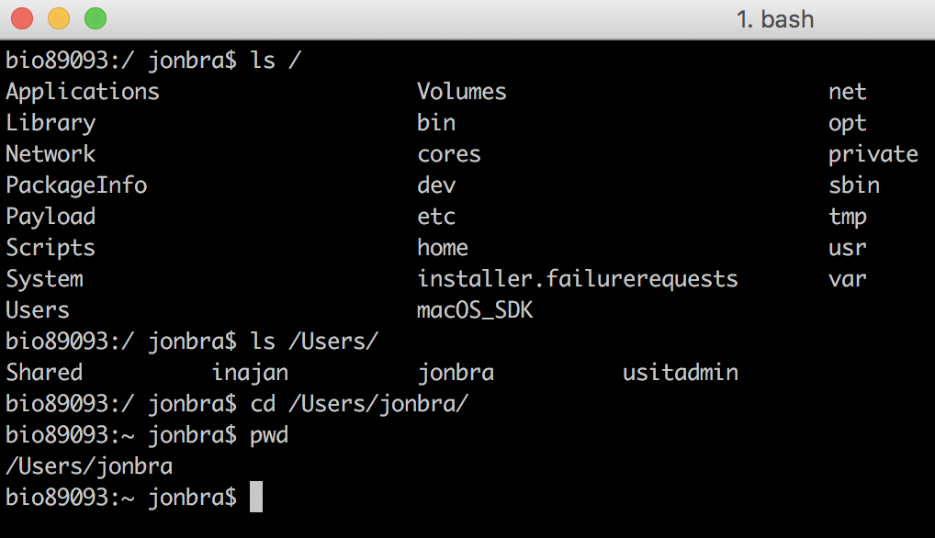
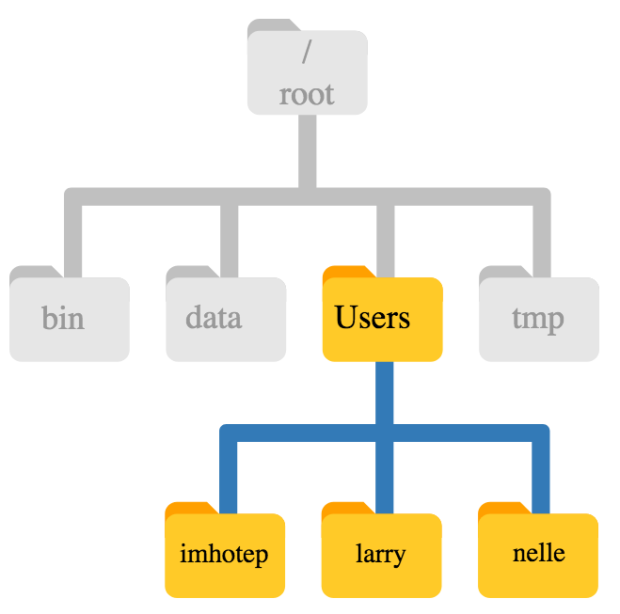
File structure
/(root)
bin
data
Users
tmp
larry
jonbra
susi

Slide 38
File structure
The home directory path may look different depending on the OS.
E.g. Windows: C:\Documents\jonbra or C:\Users\jonbra
Mac/Linux: /Users/jonbra (or something similar)
/(root)
This is usually your home directory (if you are the user jonbra)
bin
data
Users
tmp
larry
jonbra
susi

Slide 39
File structure
/(root)
The home directory is also ~/ or $HOME
“tilde” character!
bin
data
Users
tmp
If you are logged in as jonbra, ~/jonbra will also be your home directory
(~/)
larry
~/jonbra
susi
Notes:
In Unix ”tilde” represents the Home directory.

Slide 40
Navigating the filesystem
cd changes directory
ls lists the files and directories in the current directory
pwd prints the path of the current directory
~/ or $HOME is your home directory (cd will take you there)
. is your current directory
.. is the directory directly above the current
http://swcarpentry.github.io/shell-novice

Slide 41
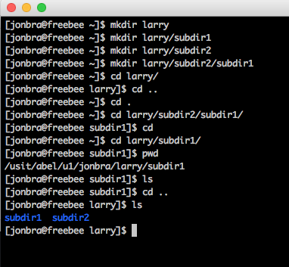
To make a new directory: mkdir
mkdir larry
To make subdirectories
mkdir larry/subdir1
mkdir larry/subdir2
mkdir larry/subdir2/subdir1
To navigate use cd (change directory)
cd larry
cd .. (takes you one level up)
cd . (you stay where you are)
cd (shortcut directly to your home directory)
To find out where you are, use pwd (print working directory)
To list the files and directories in the current directory use ls
/
root
bin
data
Users
tmp
larry
jonbra
susi
subdir1
subdir2
.
.
.

Slide 42
Transfer files
You will learn to transfer files between Saga and your laptop (both ways) in the exercises
We will use the command line with scp
You can use software such as
WinSCP (for windows)
Fetch (Mac)
Cyberduck (Mac)

Slide 43
Transfer files with scp
scp is used to copy files from one machine to a remote machine over a secure SSH connection.
General structure:
scp <from> <to>
Example a files sent to saga:
scp file.fasta username@saga.sigma2.no:/cluster/home/username/
command
file to be sent
where to send it username@location:path

Slide 44
Remember
Linux commands are case sensitive!
ssh
is NOT the same as
Ssh
Filenames and paths are also case sensitive!
huge_file.fasta
is NOT the same as:
Huge_file.fasta
Protip: Use the tab-key to autocomplete

Slide 45
Some of the most useful commands which will be covered in the exercises
ssh - Secure log on
ls - List content
pwd - Print the working directory
cd - change directory
mkdir - make directory
cp - Copy files and directories
scp - Secure copying of files and directories
rsync - Synchronise and transfer files and directories
rm -Remove files and directories
less - Print content of file to screen
more - Print content of file to screen
head - Print the head of file(s)
tail - Print the end (tail) of file(s)
cat - Print and concatenate several files
grep - Search through text files
sort - Sort the content of files
uniq - Print unique (lines, or words)
Special operators:
> (IO redirection)
>> (IO append)
| (the vertical line is called pipe)
Useful cheat sheet: https://cheatography.com/davechild/cheat-sheets/linux-command-line/

Slide 46
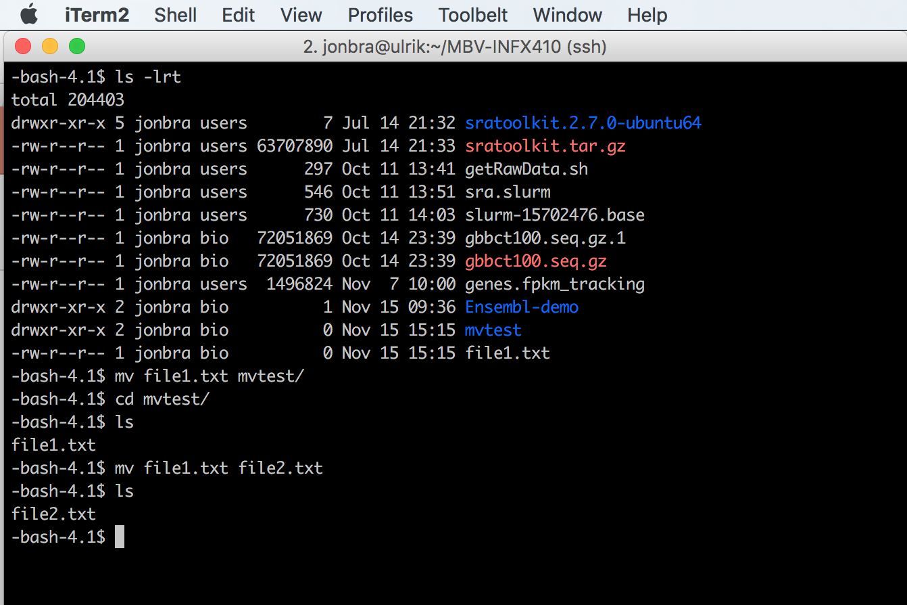
Moving files with the mv command
Move file1.txt to directory mvtest
Pro tip:
mv command can also rename files!
(“moves” file to a new filename)
Notes:
Gjøre disse tingene live

Slide 47
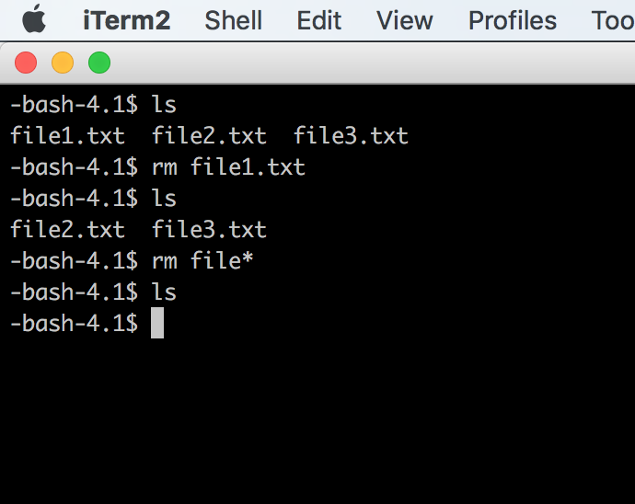
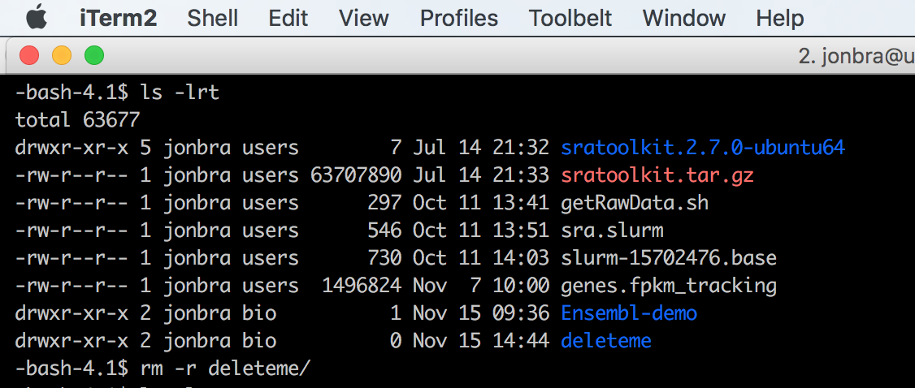
Delete files with the rm command
Delete empty directories with rm –r
Delete directories AND
files within with rm –rf Use with caution!! (rm –i)
NB! There’s no trash can on Unix!
Your files are immediately deleted!

Slide 48
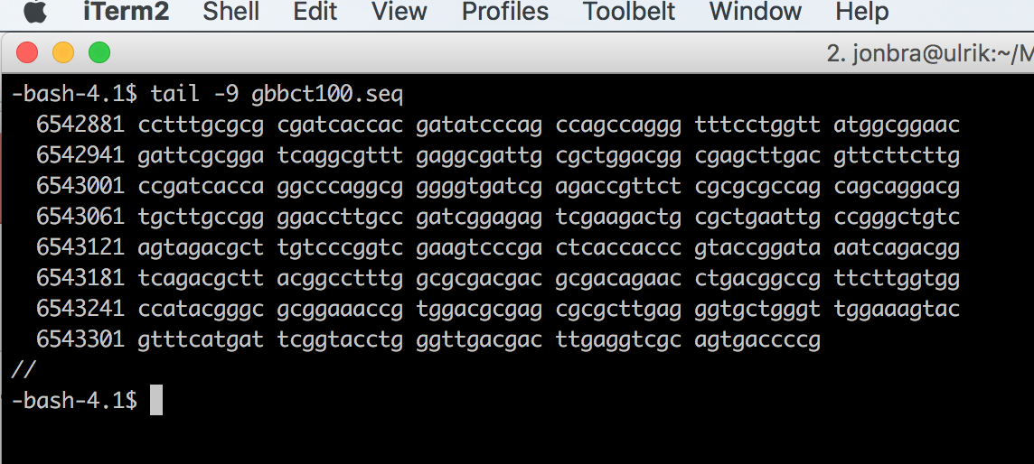
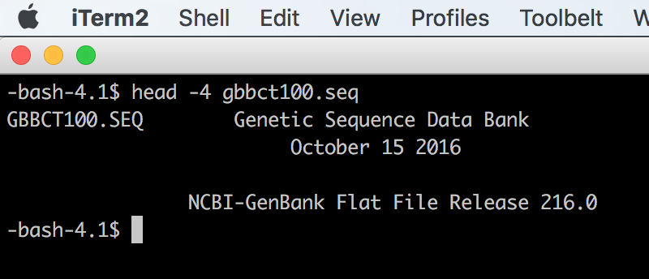
Viewing files
Pro tip:
Use the different
options to tweak the output
cat displays the entire content on the screen
less displays the content on the screen one file/line at a time (press ”q” to exit).
head/tail displays the first or last lines of a file

Slide 49
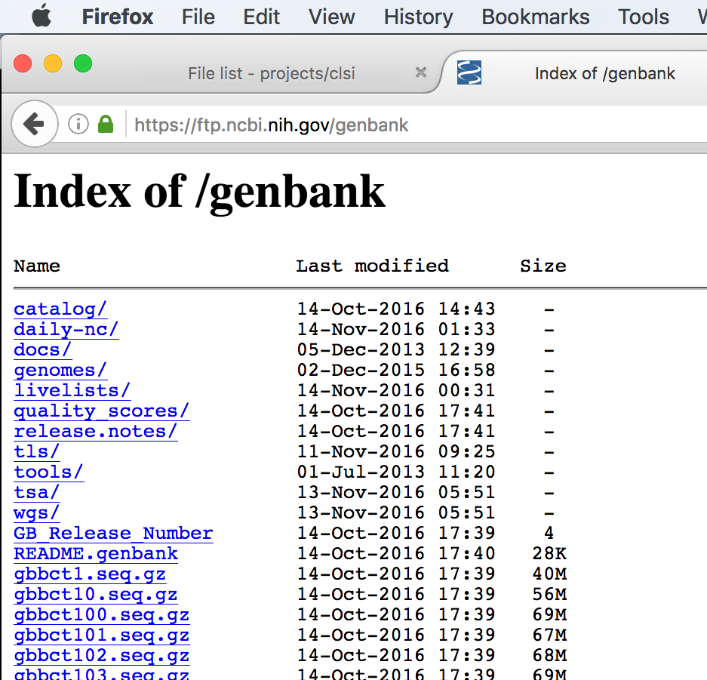
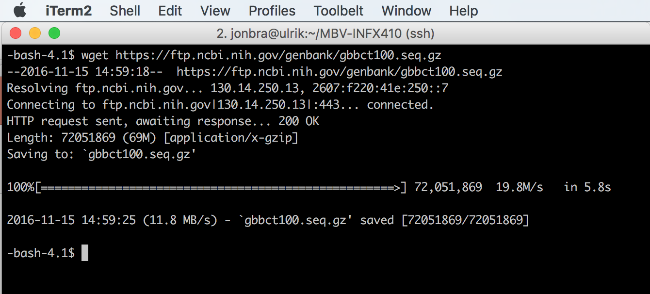
Downloading files from the internet
The wget command make it possible to download files from the web
Right-click and copy the link!

Slide 50
Redirect and pipe
Since Linux (and UNIX) use streams of text it is easy to
write the output of a command to a file.
Two versions:
The greater than symbol (>) is used to write a new files (will overwrite)
ls -lh > list_of_files.txt
Two symbols (>>) will append the content to a file
ls -lh >> list_of_files.txt

Slide 51
Redirect and pipe
Since Linux (and UNIX) use streams of text it is easy to
Use the output of one command as input in another with the horizontal line called pipe |
wc -l *fasta | sort -n
First command
Pipe
Second command

Slide 52
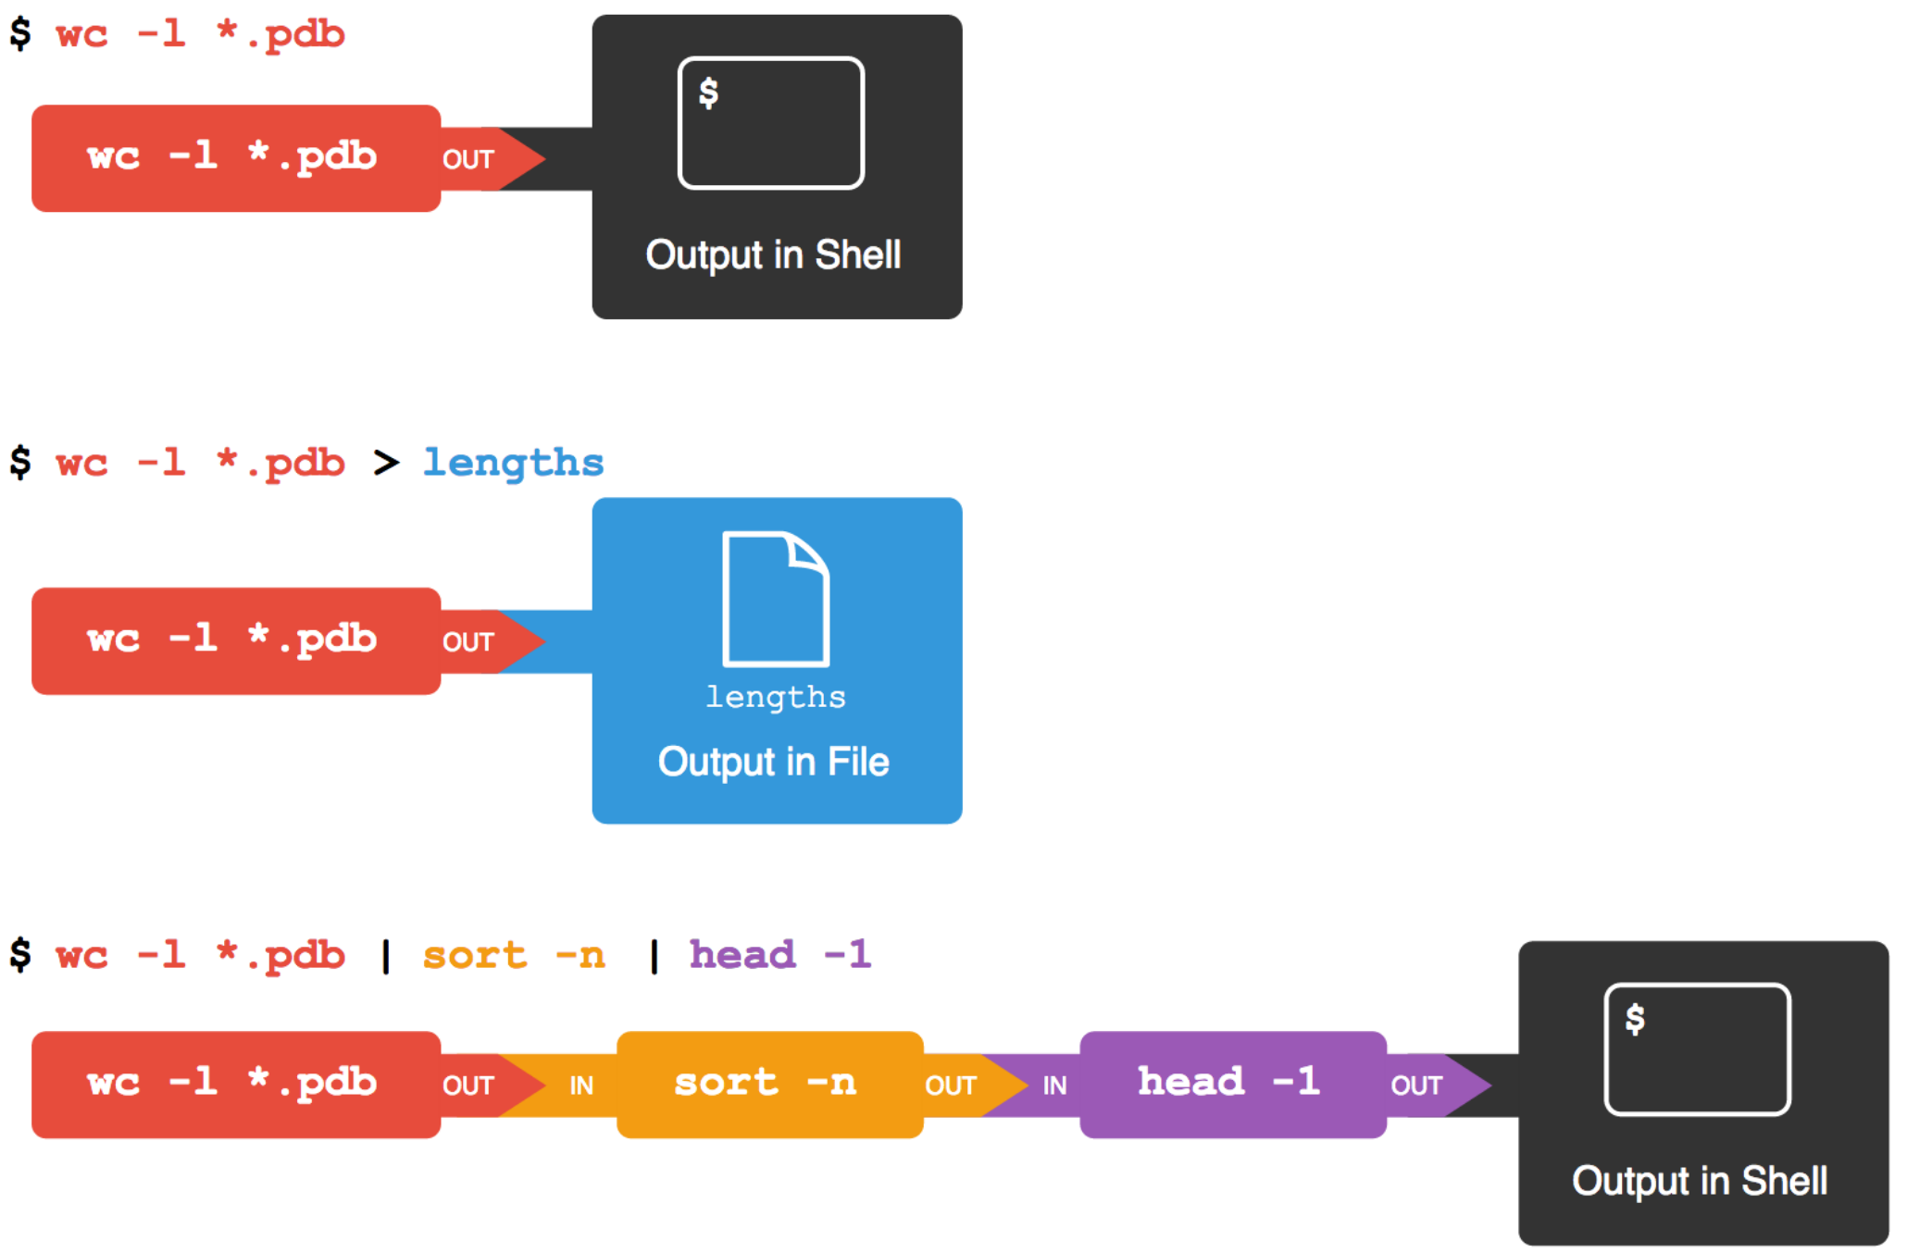

Slide 53
Piping commands together
Many commands in a row:
wc -l * | sort -n | head -n 3 > results.txt

Slide 54
Some online resources
Linux Cheat Sheet
https://www.cheatography.com/davechild/cheat-sheets/linux-command-line/
https://files.fosswire.com/2007/08/fwunixref.pdf
Vim Cheat Sheet
https://www.cheatography.com/nuggles/cheat-sheets/vim/
Nano Cheat Sheet
https://www.cheatography.com/bipinthite/cheat-sheets/nano-editor/

Slide 55
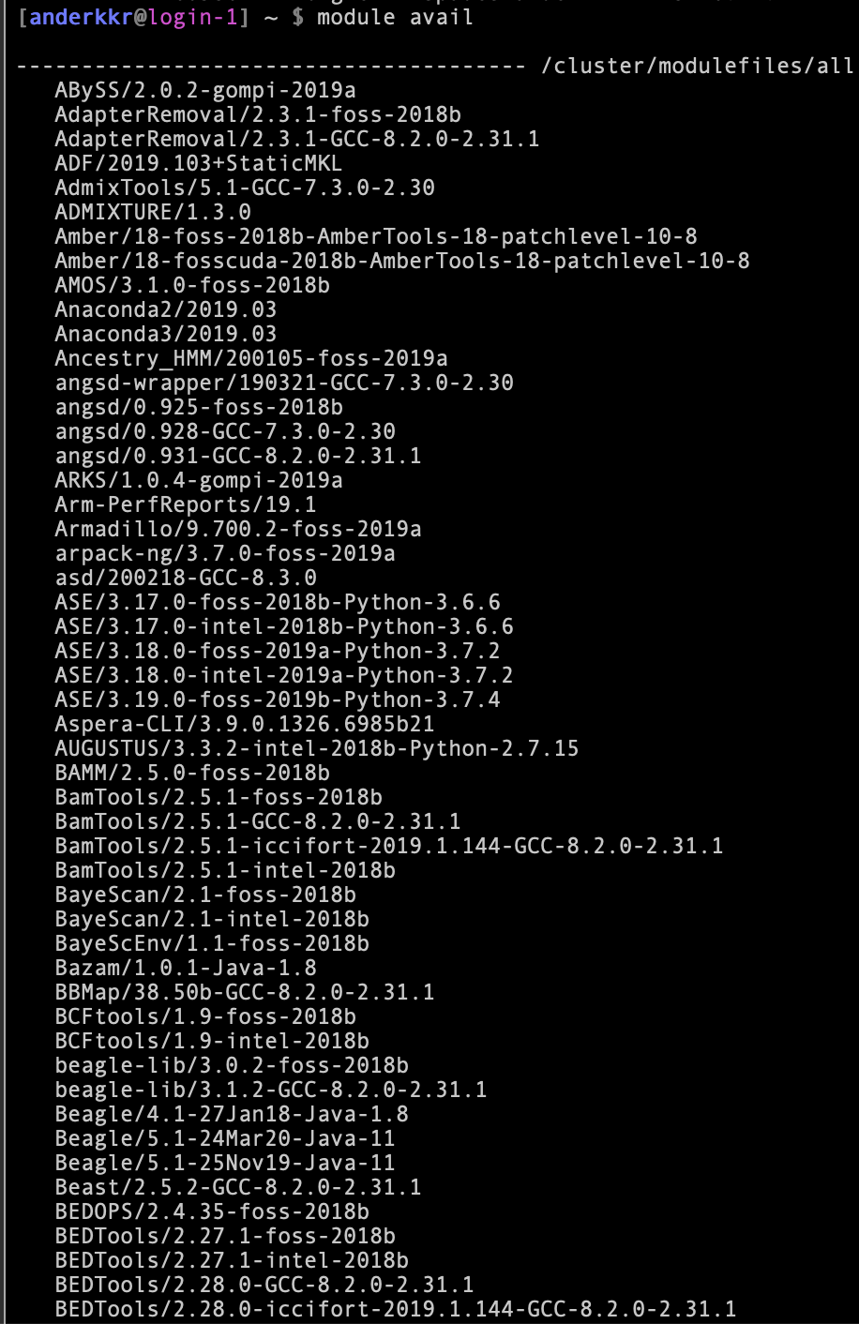
Preinstalled programs on Saga
Saga has already many preinstalled programs.
Check available modules with
module avail
These can be loaded by the command
module load <program>

Slide 56
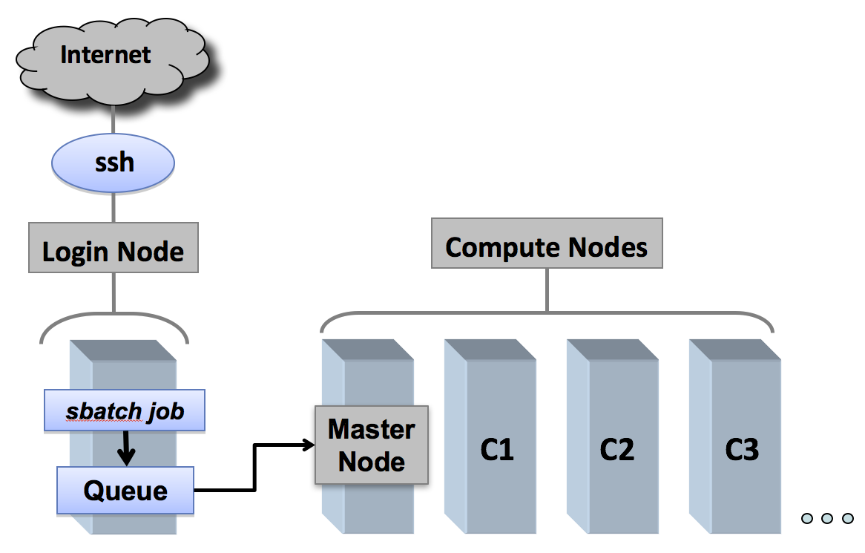
Queue system - Slurm
Since Saga is used by hundreds of people it needs a queueing system to divide the resources
The queue system is called Slurm.

Slide 57
Queue system - Slurm
Since Saga is used by hundreds of people it needs a queueing system to divide the resources
The queue system is called Slurm.
You are here

Slide 58
Queue system - Slurm
Since Saga is used by hundreds of people it needs a queueing system to divide the resources
The queue system is called Slurm.
You are here

Slide 59
Queue system - Slurm
You will use the queue system later in the course, when you will do genome assembly.

Slide 60
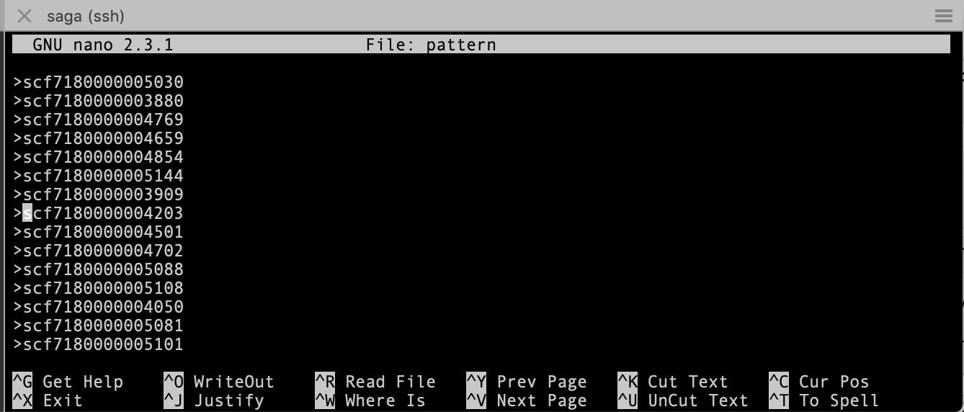
Text editors in Linux
Unix has many built-in ways editing text files.
We will be using nano in this course and it will be introduced in the exercises.
It is a very simple texteditor with simple, basic functionality.
Start:
nano filename
CTRL-x – Exits the editor. If you are in the middle of editing a file the exit process will ask you if you want to save your work.
CTRL-o – Save file name and continue working.
CTRL-w – Search your text.
CTRL-g – Get help with Nano.

